Slide 1
Creating a soccer training session

Slide 2
CONTENTS:
Warm up / Cool down.
G-A-G methodology.
Creating activities, functional / skill.
Small Sided Games. Catering a game to serve a specific purpose.
Interventions.

Slide 3
WARM UP
A warm up is valuable part of any session. It increases the blood flow to the muscles and tendons. It raises the body temperature and prepares it for more rigorous exercise. It reduces the risk of injury.
A warm up is generally broken down into three separate stages. Each stage should last approximately 3minutes. Try to spend as little time as possible explaining the exercises. Make them simple, so you can get the players moving.
PHYSICAL A range of movements and dynamic stretches (involves movement of the body) to raise the heart rate and prepare the body for physical activity.
MENTAL Games or activities designed to engage and stimulate the brain. This stage should also begin to focus the players mind on the session ahead.
TECHNICAL Games or activities to introduce ball familiarity. This stage can also be utilized to introduce the topic and focus of the session ahead.

Slide 4
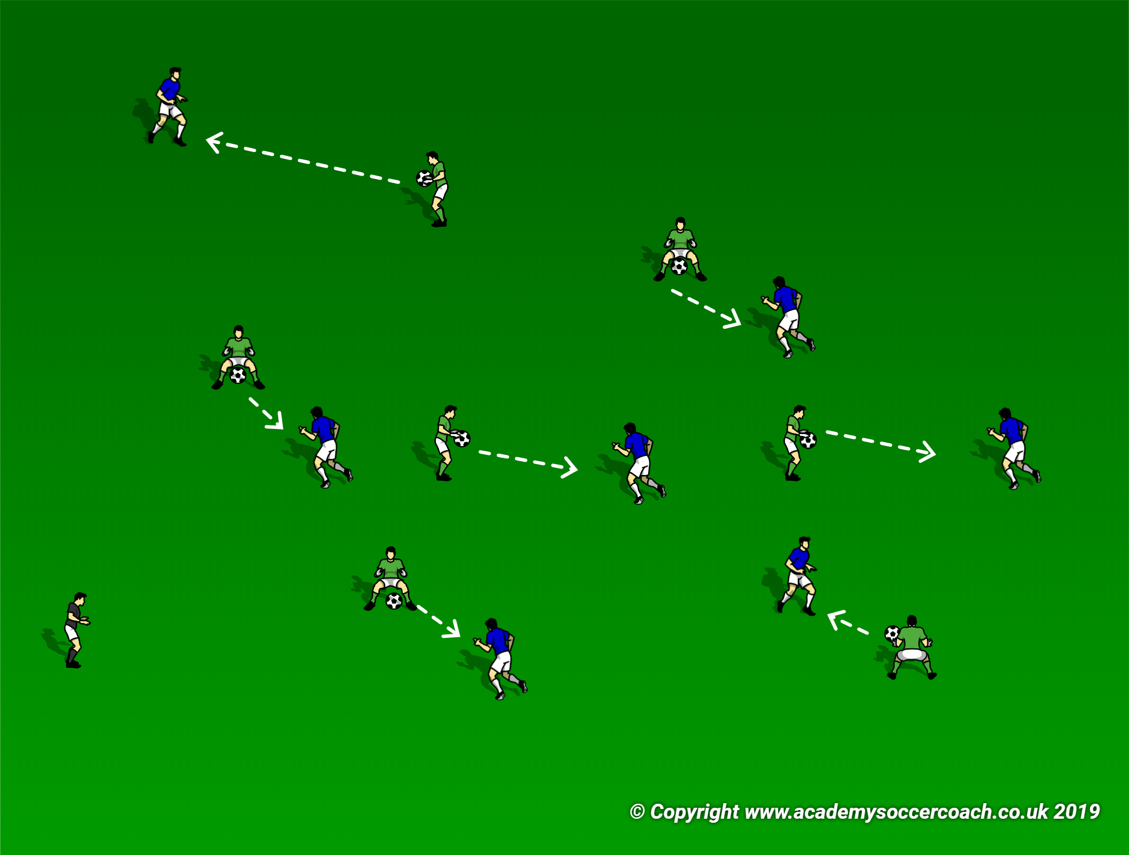
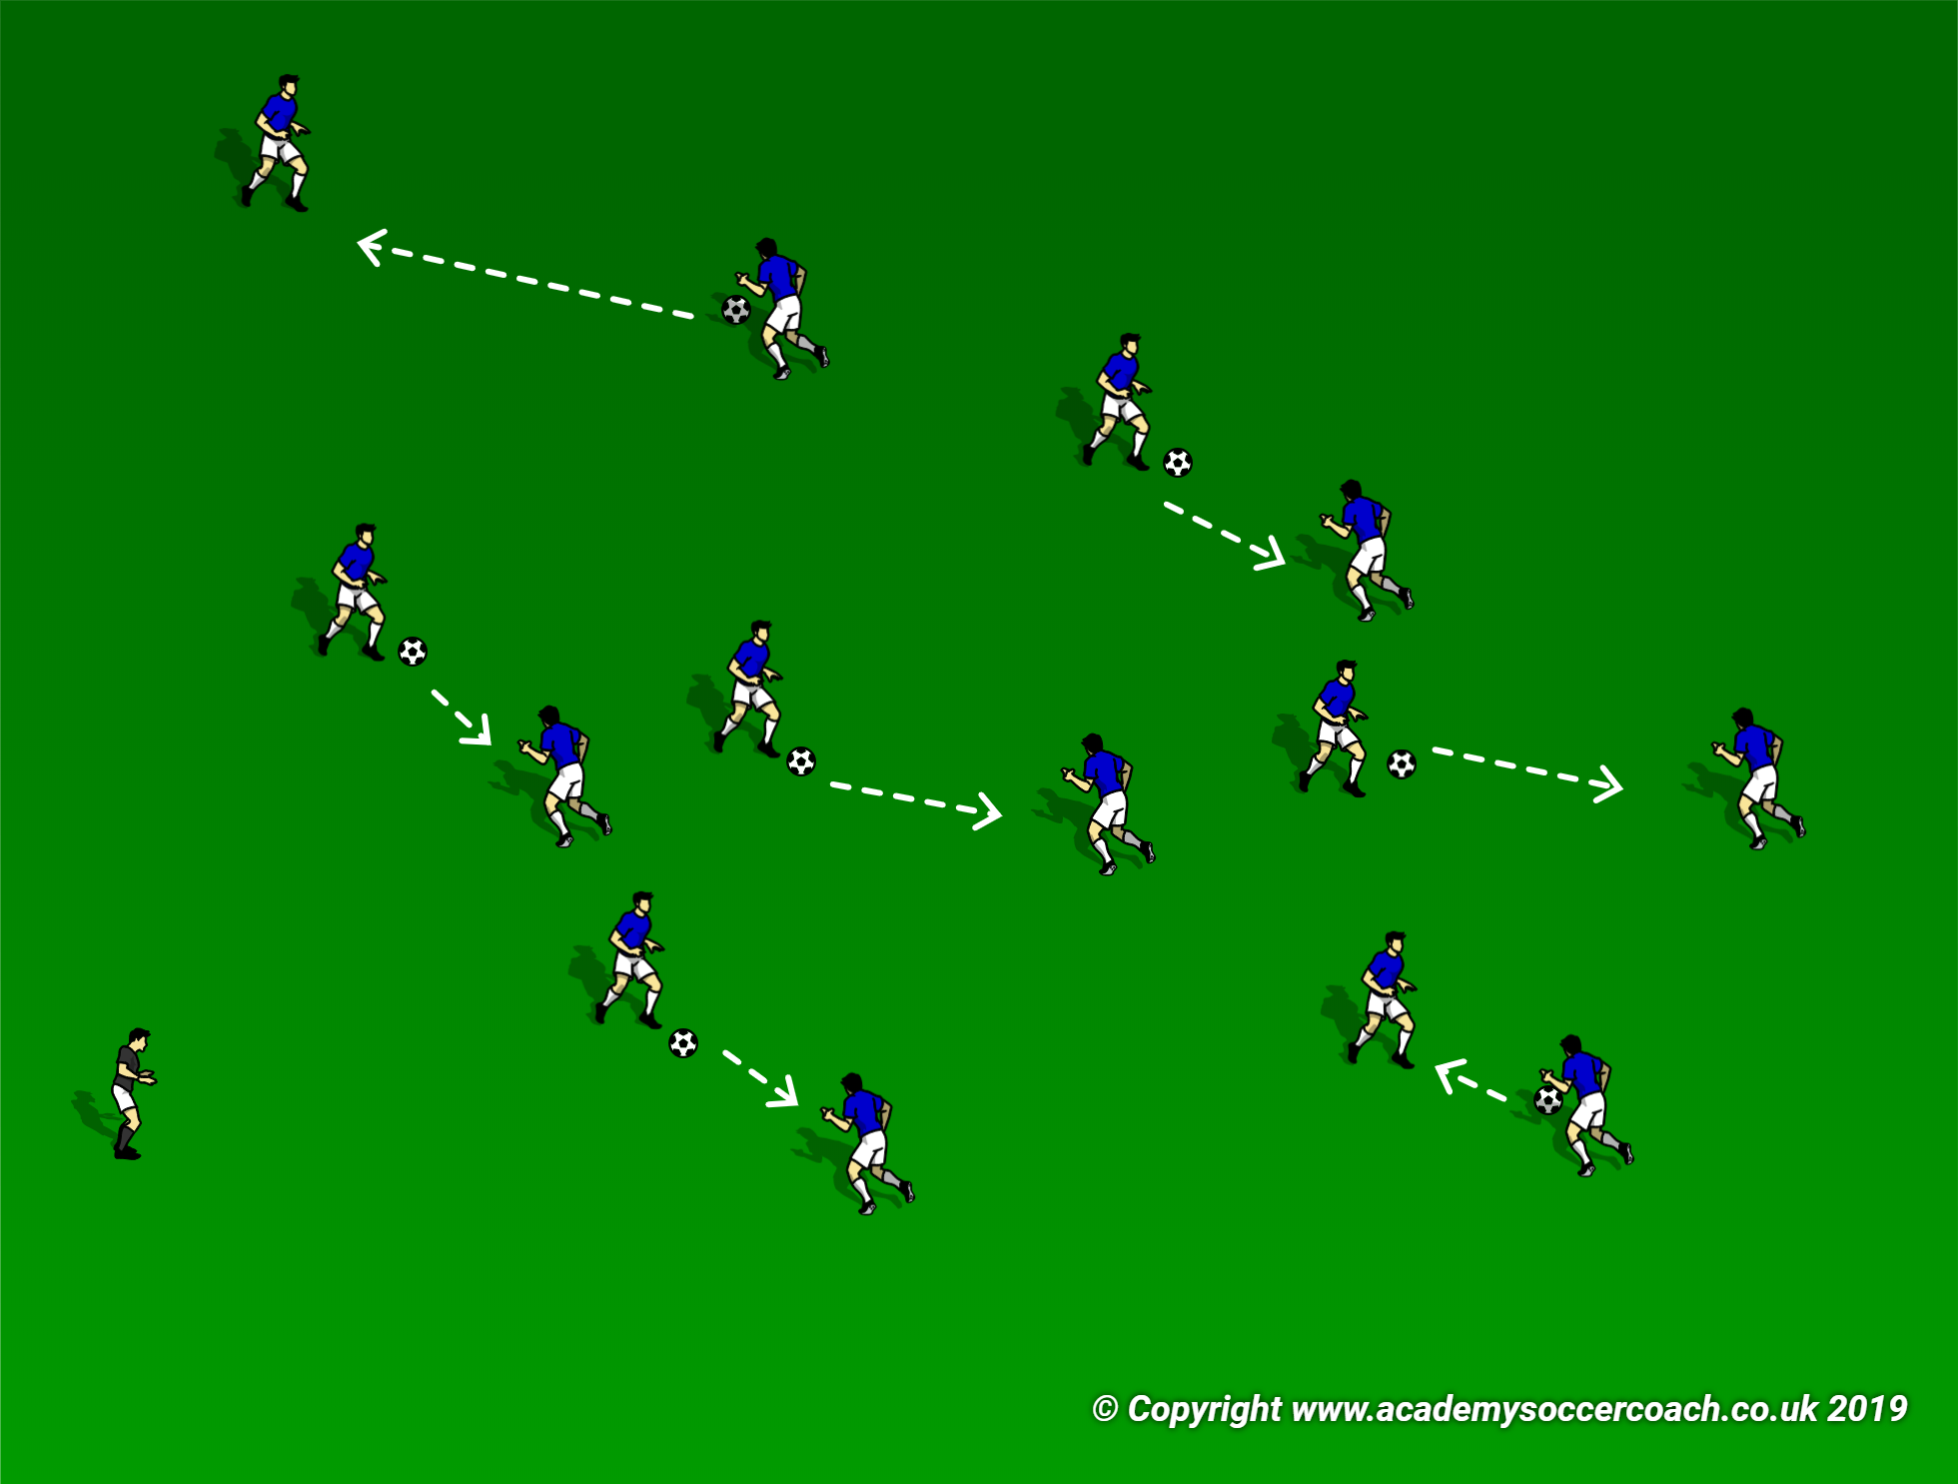
WARM UP EXAMPLE:
PHYSICAL MENTAL TECHNICAL
-Players jog lightly and perform dynamic stretches that encompass all of the major muscle groups.
-Players perform different movements (side steps, jumping, crouching over a ball etc.).
-The players approach various balls and touch them with a specific part of their body.
-The players run and touch any 3 balls with their hand.
Half of the players pick up a ball. The other players approach a ball carrier and react according to the ball carriers instructions:
1-Left foot volley back to carrier.
2-Right foot volley back to carrier.
3-Header pack to carrier.
4- Player catches ball and becomes a carrier.
-Ball carriers place the ball at their feet and begin to dribble. Other players look for a pass.
-Players alternate which foot they receive the ball with.
-Players scan the area surrounding them and attack any space with their first touch.
-Players try to turn and switch directions with their first touch.

Slide 5
COOL DOWN
The cool down is equally as important as the warm up. It benefits the athlete in the following ways:
It brings the heart rate down at a controlled rate, which in turn benefits the cardiovascular system.
It reduces the effects of DOMS (delayed onset of muscle soreness).
It helps to re-lengthen the muscles.
A cool down should involve light movements which gradually decrease in tempo. This is followed by a range of static stretches to the major muscle groups, performed while the players are sitting down.
The stretching section can and should also be utilized as a reflection and debrief session.

Slide 6
Section structure – G.A.G. methodology
GAG stands for GLOBAL -ANALYTICAL -GLOBAL. Or more simply GAME -ACTIVITY -GAME.
GLOBAL 15 mins – The first game gives the coach an opportunity to introduce the theme of the session, by intervening and highlighting specific sequences during the play. The first game can be adapted to increase the opportunity for the players to perform the desired skills. There must be opponents, targets (not necessarily goal posts) and rules. If the session is based around dribbling and attacking the space, you could adapt the target and utilize end zones to dribble into, instead of regular goals.
ANALYTICAL 15 mins – This section should include an activity that repeatedly focuses on the theme of the session. It is important that the coach knows exactly what the theme is, so they can choose an effective activity. For the dribbling and attacking space theme, a 1v1, or 2v2 activity with end zones could be used.
GLOBAL 20-25 mins – This final game should be as realistic as possible. Goals should be included and the rules should be realistic. This is an opportunity for the coach to observe if the players are able to implement the skills they have learnt in a real game situation. Try not to intervene unless it is absolutely necessary. Let the players try to think themselves out of situations.
Below is a webinar from Canada Soccer to further explain the methodology:
Https://www.ontariosoccer.net/news_article/show/762439-webinar-let-the-game-be-the-teacher-gag-methodology-

Slide 7
Creating activities (the 3 r’s)
REALISTIC - Is the activity real to the game? (can it be transferred into a real game situation).
- Is the activity game based?
- Are the principles of play evident in the activity?
- Are the laws of the game part of the activity?
RELEVANT - Is the activity relevant to the age and ability of the players?
- Is the activity relevant to the theme of the session?
- Is the activity relevant to the game?
REPETATIVE - Are all of the players given equal opportunity to try the task?
- How often do players get the opportunity to repeat the task?

Slide 8
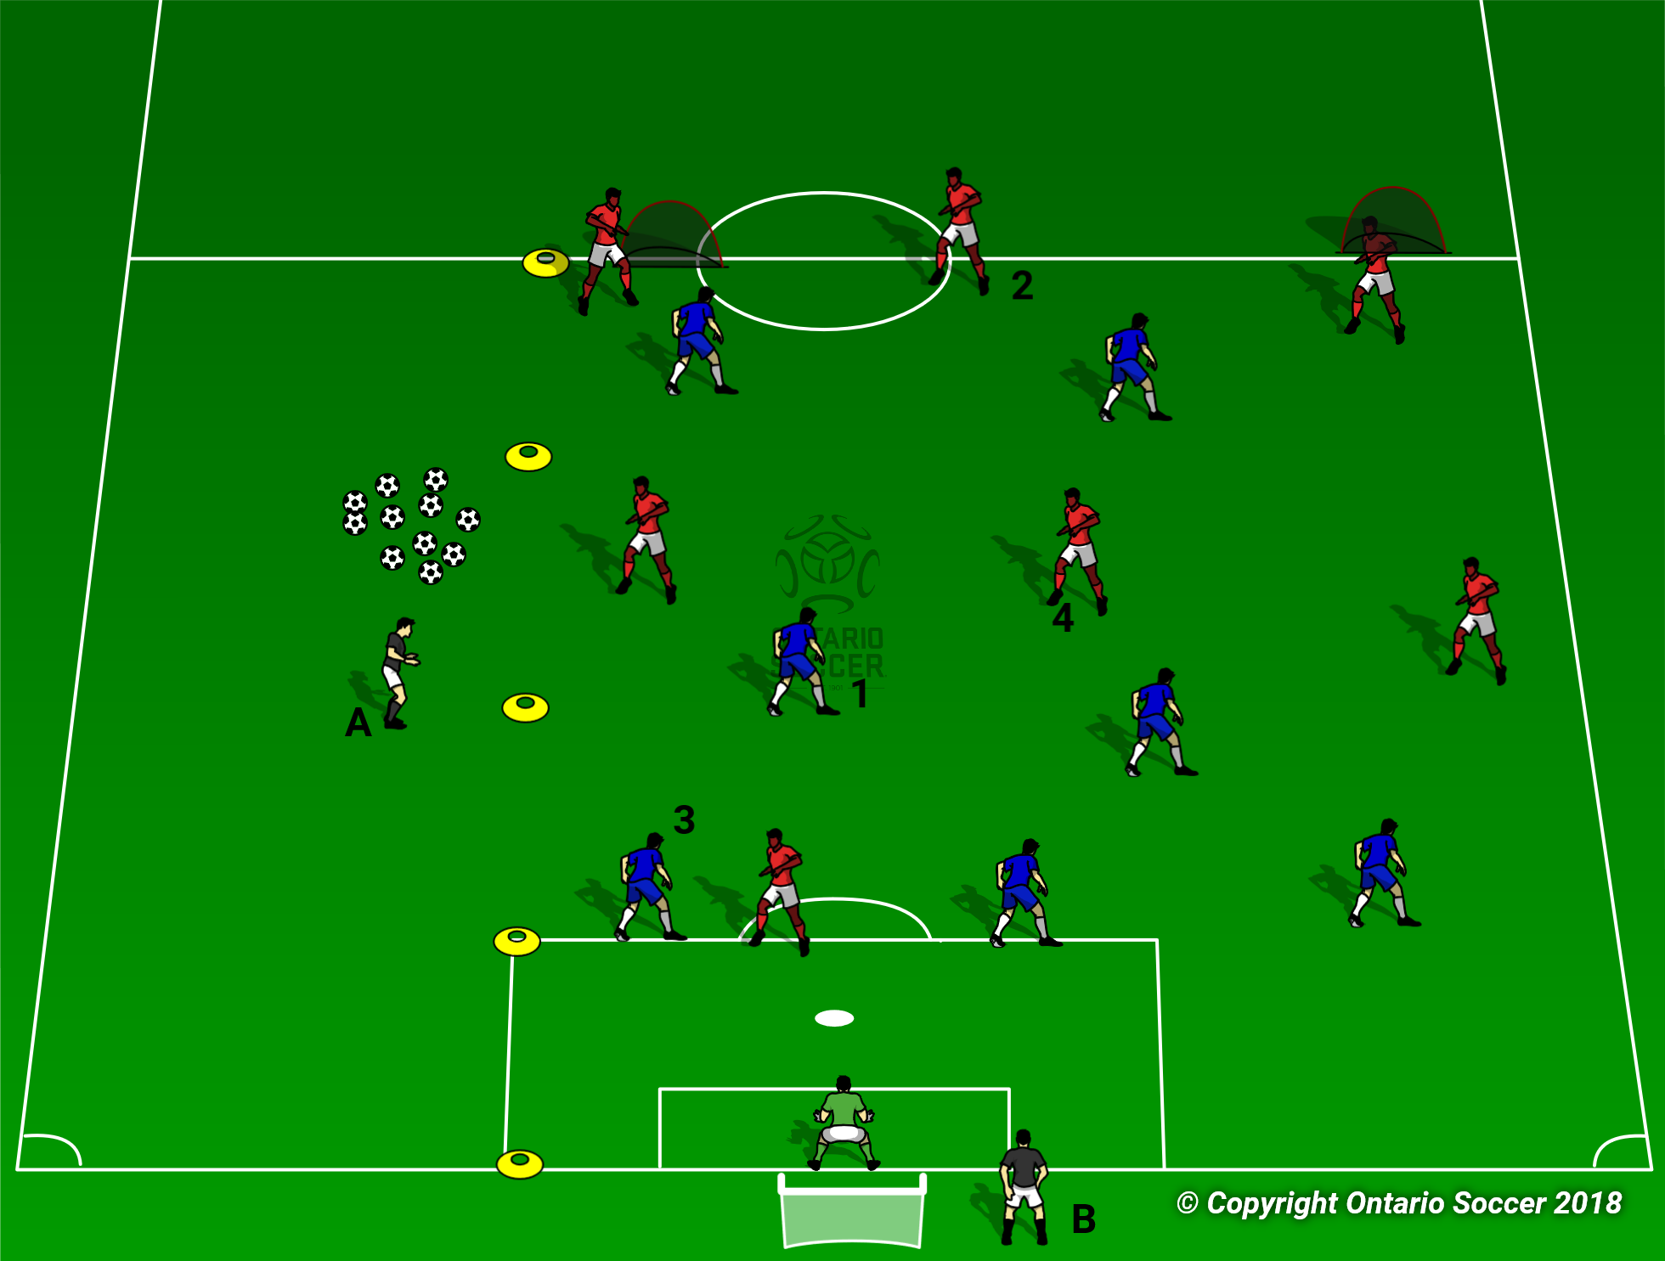
Creating activities (skill vs functional)
ANALYTICAL – SKILL: Activity incorporates the principles of the game, but takes place in an area designated by the coach. The size of the area will be determined by the age and ability of the players. This activity should give the players lots of opportunity to repeat the themed skills and techniques of the activity.
The illustration shows an activity in which an attacker has to find space to receive a pass and transition the ball to an available player . This gives the coach ample opportunity to intervene and highlight the desired skills and techniques. Rotation of players gives all players the opportunity to practice the skills. This activity should have specific principles of the game incorporated into them.
ANALYTICAL – FUNCTIONAL: The activity takes place on a specific part of the field. It incorporates realistic scenarios that allow the players to easily see how the skills relate to a real game situation.
The illustration gives an example of a realistic defending situation. The blue team are defending an attack down the right side of the field. This activity gives the coach a great opportunity to intervene and explain where players should be and why this affects the play. The activity should incorporate principles and laws of the game.

Slide 9
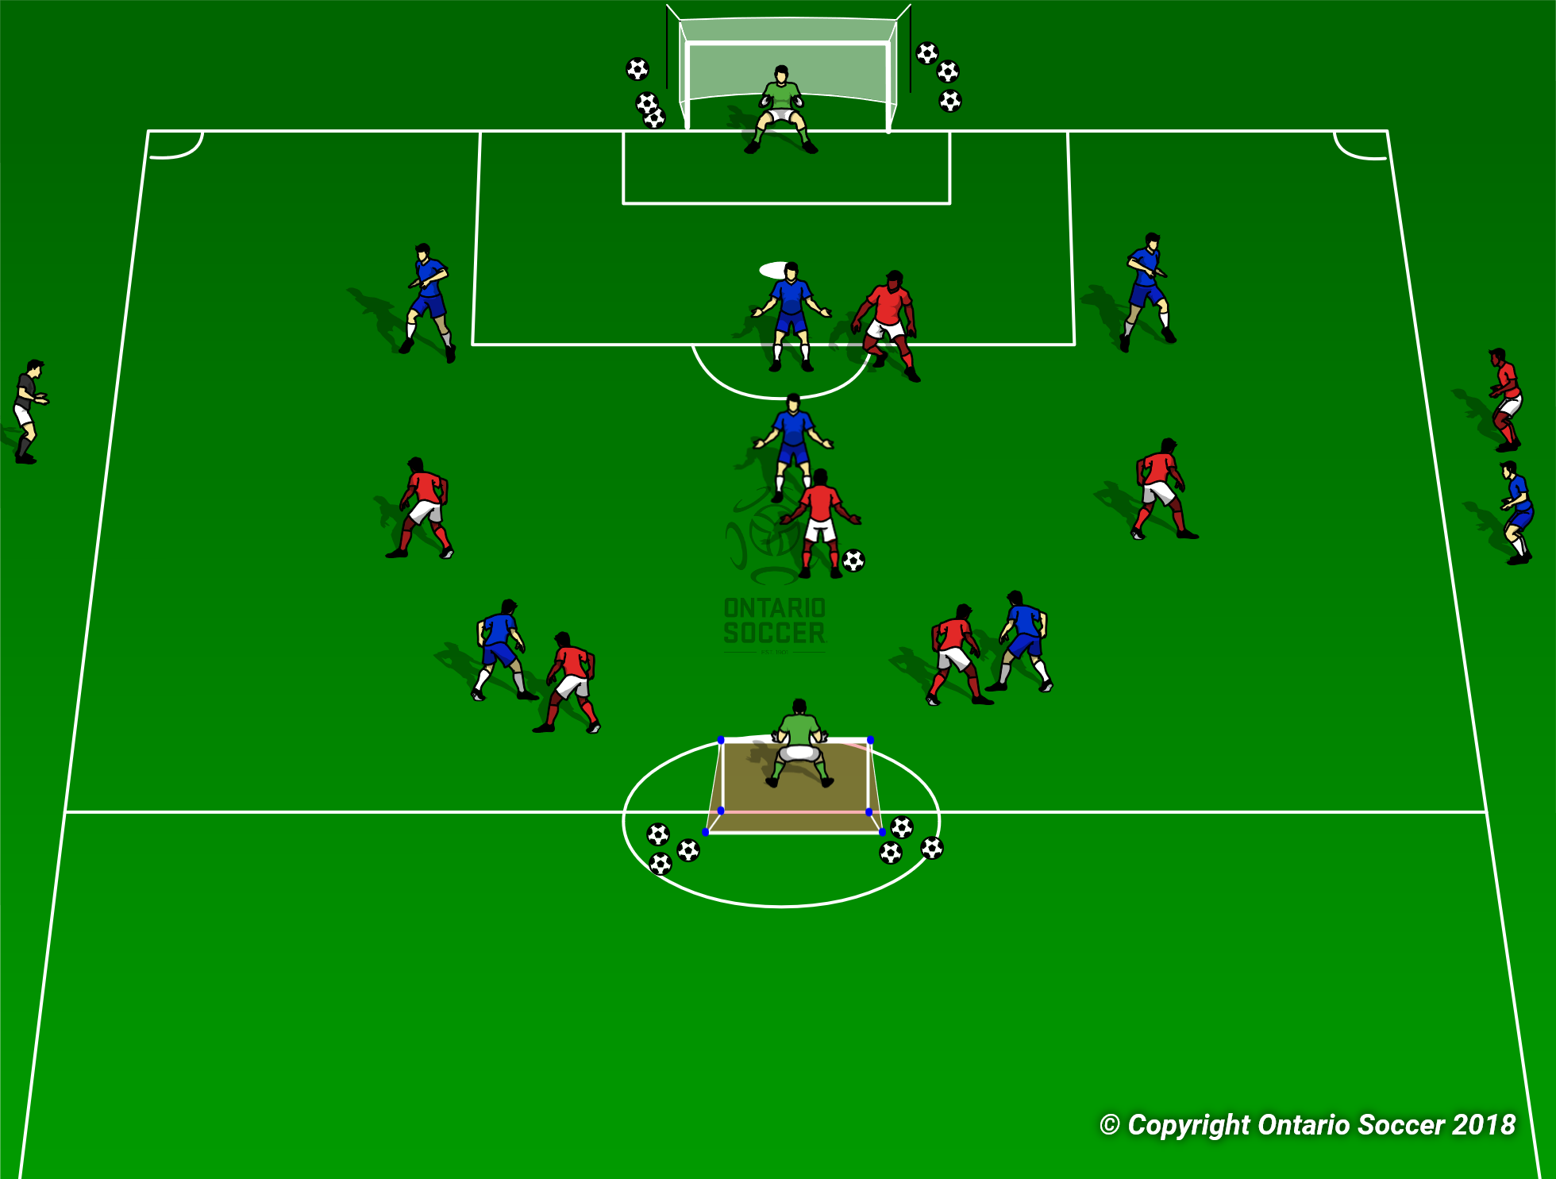
Small sided games
Small sided games give us an excellent opportunity to intervene and coach the players in real time. Every practice session should have a specific lesson, technique or skill that you will focus on throughout the session. Small sided games should incorporate principles and laws of the game. The structure of the game can be adapted however, to allow for a specific scenario to arise repeatedly.
The illustration shows a small sided game, where the formations have been specifically chosen to aide the session.
The focus of the activity is “Defending The Flank”. The coach would stress to the players to keep within their lines, and encourage the red team to disperse and stretch the field. The formations allow the red team to get plenty of opportunities to try and stretch the blue defence with their unmarked wingers. The coach can now work on defensive positioning with the blue team.

Slide 10
interventions
LEARNING STYLES:
It is important that we are aware of these learning styles when we coach our players. Always try to demonstrate what you want the players to do and also get them to practice, so you know that they understand what you are coaching.
This can also be an effective method of explaining an activity to the players. Use diagrams, or simplified demonstrations to ensure that the players understand the activity. This will allow you to initiate the activities more quickly.

Slide 11
INTERVENTIONS - Coaching styles
COMMAND: Coach makes all of the decisions. The players role is to follow the decisions without question. This can be effective for younger players, or players who have little understanding of the game.
“When you receive the ball, I want you to look up quickly and pass the ball to a wide player”.
QUESTION AND ANSWER: Coach asks direct questions to the players. This gives the coach the opportunity to gauge if the players understand the topic of the activity. It also gives an opportunity for the players to get more involved with their development and gain in confidence.
“STOP! In this situation, where is the best space for you to create a wide passing option for the ball carrier?”
GUIDED DISCOVERY: Coach will engage with the player, or the team and try to encourage them to solve problems on their own. The questions will be less direct and more vague.
“How can you work as a team to give the centre back more passing options when they receive the ball”
“Show me how you could stretch the defense and make space for better passing and dribbling options.”

Slide 12
INTERVENTIONS – BUILDING BLOCKS
When we coach players principles, skills and techniques, it is important that we stick to the topic of the session and don’t attempt to fix every mistake. It is usually a good idea to pick one principle, skill, or technique as the focus for a session.
CONSIDERATIONS WHEN INTERVENING IN SESSIONS:
Make sure that the intervention is relevant to the topic of the session.
Which team are you coaching? (It is easier for activity creation if you plan it around coaching only one team).
Recognize situations when a coaching opportunity may arise.
Are the frequency of interventions affecting the flow of the play.
Which coaching style will get the message across most effectively?

Slide 13
PRINCIPLES OF SOCCER – ATTACKING
PRINCIPLES OF ATTACK
ATTACKING SKILLS AND TECHNIQUES
PENETRATION
DISPERSAL
(WIDTH)
IMPROVISATION
FINISHING
MOBILITY
DEPTH
(SUPPORT)
PASSING
DRIBBLING
RUNNING WITH THE BALL
RECEIVING THE BALL
SHOOTING
HEADING
U13+

Slide 14
PRINCIPLES OF SOCCER– DEFENDING
PRINCIPLES OF DEFENSE
DEFENDING SKILLS AND TECHNIQUES
PRESSURE
CONTROL AND
RESTRAINT
COMPACTNESS
BALANCE
COVER
DELAY
MARKING
TRACKING
JOCKEYING
SCREENING
BODY POSITION
HEADING
U13+

